Slide 1
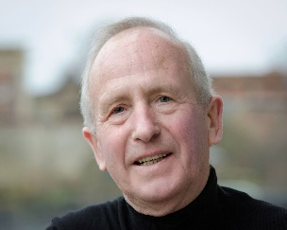
An Introduction to Experimental Economics
John Hey
Presentation to the Masters Students, University of Bari
November 2023

Slide 2
Introduction
I am John Hey, Emeritus Professor of Economics and Statistics at the University of York.
You can find this presentation at
https://www.york.ac.uk/economics/exec/universityofbari/
I am visiting the University of Bari, where I was Ordinario for 5 years, taught Microeconomia and Social Choice, and founded the Bari centre of experimental economics, to convince you all of the value of Experimental Economics , and to encourage you to use it.
You can find my webpage at
https://sites.google.com/york.ac.uk/john-hey/home
You can send me emails at john.hey@york.ac.uk

Slide 3
Experimental Economics and Behavioural Economics
These are very closely interlinked. Each feeds into the other.
Behavioural Economics is a branch of Economics which describes the economic behaviour of human beings.
(This really is what economics ought to be about, but conventional (neoclassical) economics has too strong assumptions about human rationality. Behavioral economics relaxes these assumptions.)
Experimental Economics is a method by which economic theories (both behavioural and conventional) are tested for their validity.
If the test shows that the theory is valid, all well and good.
If not, the theory is revised…
… and then tested again, and so on, until it is valid.

Slide 4
Preamble
This is a lecture on experimental economics,
And not on experimental psychology
Or experimental anything-else.
I presume a basic understanding of economics.
Stop me if I am assuming too much.

Slide 5
This lecture
This is an overview lecture giving you a glimpse of what experimental economics is about and what an economics experiment looks like.

Slide 6
Overview
I first look at markets
Then games
Then static individual decision-making
Then dynamic individual decision-making
Then a very brief overview of other experiments.
But first, three questions for you…

Slide 7
A first question for you
What would you think about a scientist who wants to test the efficiency of a drug
who collects data on the sale of the drug (in some town or region or country) and data on the incidence of the problem that the drug is supposed to cure (in that town or region or country),
and statistically looks at the relationship between the latter and the former?

Slide 8
A second question for you
What would you think about a scientist who wants to test whether a new brand of tyres is safer than the old one
who collects data on the sales of the tyre (in some town or region or country) and data on motor accidents (in that town or region or country)
and statistically looks at the relationship between the latter and the former?

Slide 9
A final question
What would you think about a scientist who wants to test whether raising interest rates increases saving
who collects data on interest rates over time in some country and saving in that country,
and statistically looks at the relationship between the latter and the former?

Slide 10
The answers in each case?
We would not be impressed.
One problem is that there are many other factors which may affect the relationship.
In the first two cases the scientist would conduct a laboratory experiment.
Keeping all other factors (not of interest) fixed.
Why cannot economists do the same?
Well, experimental economists do.

Slide 11
Economics
Economics is theory driven and based on axioms.
Economics has strong notions about rationality, particularly about rational expectations and dynamic behaviour.
Central to economics is equilibrium.
Economics usually relies on indirect tests of theories (using data from the economy with many uncontrolled factors) rather than direct experimental tests under controlled conditions.

Slide 12
Experimental economists’ claims
All theory is built on top of individuals (usually maximising their own self-interest).
Theory does not specify which individuals.
We can test/investigate most economic theories, including macro models and those of international trade ‒ as these usually involve a small number of (representative) agents.
Experiments enable us to find what is wrong with existing theories and to suggest new ones.
This appears to us to be scientific progress.
Let me start with an example.

Slide 13
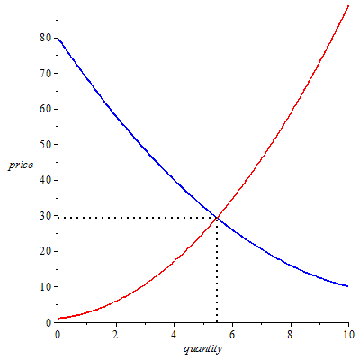
“Equilibrium” A familiar text-book figure

Slide 14
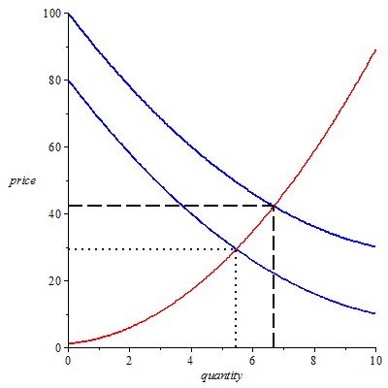
“Comparative statics” A familiar text-book exercise

Slide 15
What does the theory say?
That equilibrium exists.
It is an equilibrium in the sense that once we are there, no individual can gain by changing his or her decision.
That if there is an upwards shift in the demand curve then the equilibrium price and quantity increase.
Does it say that the equilibrium will be attained?
No.
Does it say that the price will move upwards?
No.
It cannot – because there is no-one to set the price.

Slide 16
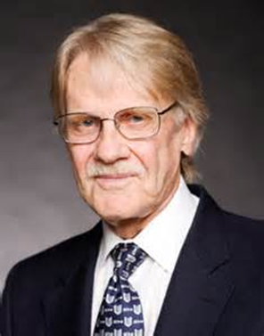
So why not see what happens?
We need to give the agents the ability to announce prices (not necessarily set them).
This is what Vernon Smith (Nobel Prize Winner in 2002) did in his path-breaking experiments in the 1960’s.
We need to give incentives to the agents/subjects to act as in the theory.

Slide 17
How we set up a market experiment
Notice that this is a market for a hypothetical good.
We need to answer the following questions:
How do we get people to act as potential buyers?
How do we get people to act as potential sellers?
How is the price formed?
What might the experiment tell us about the theory?

Slide 18
Demanders
What is a demand curve?
What are reservation prices?
What does a demand curve for a discrete good look like?
Suppose an individual wants to buy at most one unit of a discrete good and his/her reservation price* for the one unit is 6. What does his/her demand curve look like? what does it tell us?
* The maximum that he/she is willing to pay.

Slide 19
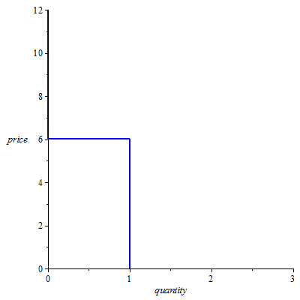
Demand curve of this demander

Slide 20
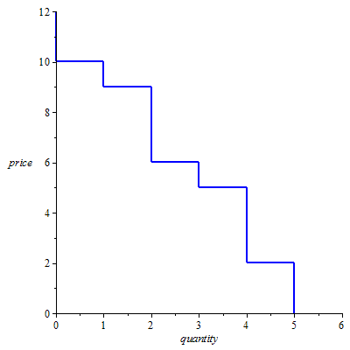
Aggregate demand curve
Suppose now there are five demanders, each wanting to buy at most one unit, with reservation prices 10, 9, 6, 5 and 2. What does their aggregate demand curve look like?

Slide 21
Inducing subjects to act as demanders
How do we do this?
We tell each subject that they are potential buyers of a hypothetical good that will be traded in the experiment, and that if they buy they will be paid by the experimenter a given sum of money (their reservation value – but we do not use this word) and that they will have to pay the price agreed out of this money.
An obvious incentive mechanism. They get their surplus.
We can obviously generalise this.

Slide 22
Suppliers
What is a supply curve?
What are reservation prices?
What does a supply curve for a discrete good look like?
Suppose an individual wants to sell at most one unit of a discrete good and his/her reservation price* for the one unit is 5. What does his/her supply curve look like?
* The minimum that he/she is willing to accept.

Slide 23
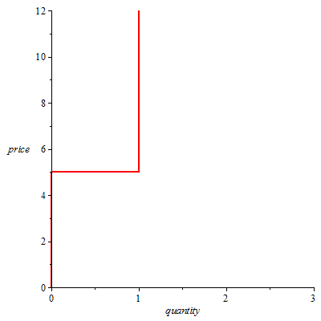
Supply curve of this supplier

Slide 24
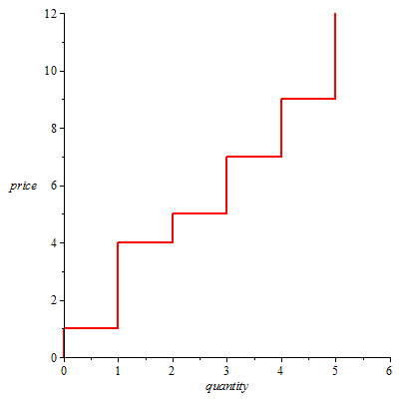
Aggregate supply curve
Suppose now there are five suppliers, each wanting to sell at most one unit, with reservation prices 1, 4, 5, 7 and 9. What does their aggregate supply curve look like?

Slide 25
Inducing subjects to act as suppliers
How do we do this?
We tell each subject that they are potential sellers of a hypothetical good that will be traded in the experiment, and that if they sell they will receive the price agreed and that they will have to pay to the experimenter a given sum of money (their reservation value – but we do not use this word) out of this money.
An obvious incentive mechanism. They get their surplus.
We can obviously generalise this.

Slide 26
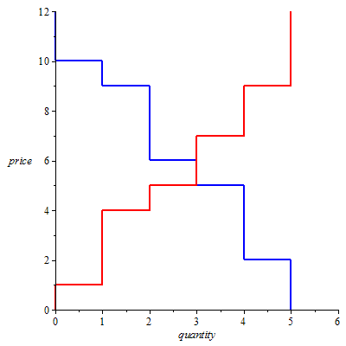
The market

Slide 27
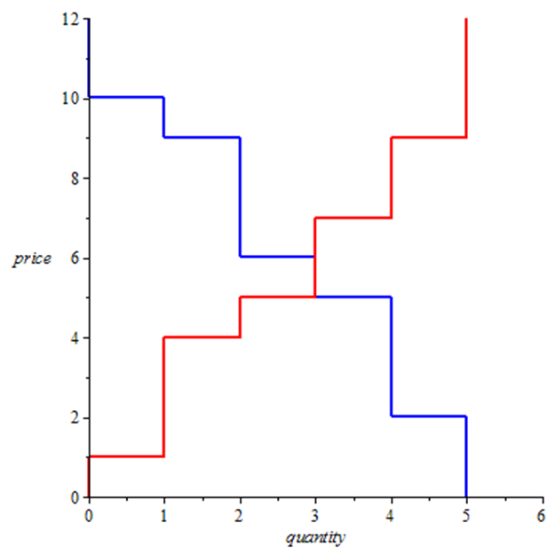
Who trades?
Do all in the competitive equilibrium?
Can all outside competitive equilibrium?
Why do we like competitive equilibrium?

Slide 28
Trading mechanisms?
In the theory? In the real world?
I list some here.
Double Auction
Walrasian Auctioneer
Clearing House
Bilateral Bargaining
Sellers set prices
Buyers set prices
…

Slide 29
Double auction
The market period lasts a pre-determined time.
At any point buyers can make bids: a price at which they are willing to buy.
At any point sellers can make asks: a price at which they are willing to sell.
Bids and asks are posted.
At any time a buyer can accept a posted ask of a seller – and then a trade takes place at that price.
At any time a seller can accept a posted bid of a buyer – and then a trade takes place at that price.
There is no communication between the subjects and they do not know each others reservation prices.

Slide 30
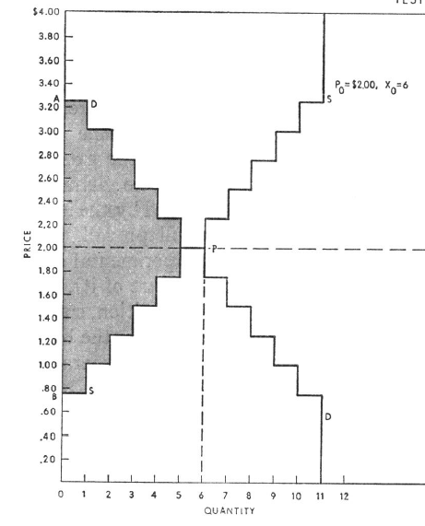
The classic example from smith 1962
11 potential buyers with reservation prices from 3.25 to 0.75.
11 potential sellers with reservation prices from 0.75 to 3.25.
Equilibrium price 2.00.

Slide 31
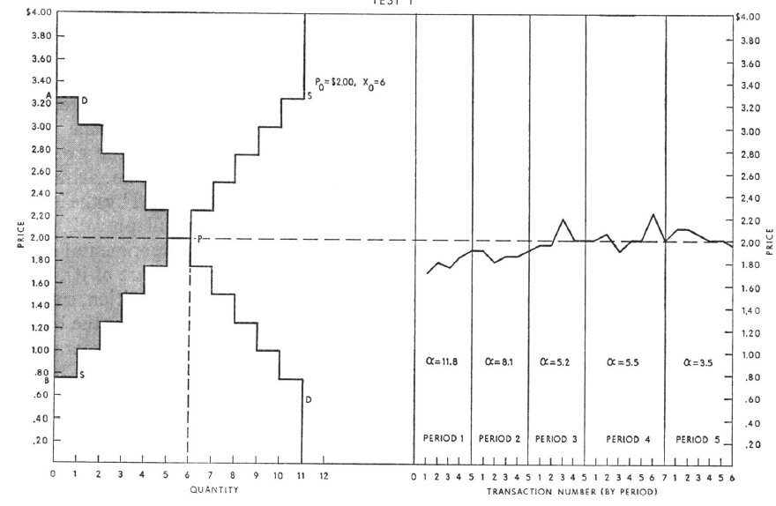
What happened in period 1?

Slide 32
What happened in period 2?

Slide 33
What happened in period 3?

Slide 34
What happened in period 4?

Slide 35
What happened in period 5?
Magic!?

Slide 36
The theorists are vindicated!
But…
A repeated market – repeated 15 times.
From Smith, Suchanek and Williams 1998
All subjects endowed at the start with units of an asset that paid a random dividend with mean 24 cents each period. Endowed also with ultimately worthless experimental money with which to trade.
Note what should be the equilibrium price of the asset:
At the start with 15 periods to go, in each of which the expected dividend is 24, the price should be the value of the asset=15*24=360. (This assumes that subjects are risk-neutral.)
Then the price should fall 24 cents each period.

Slide 37
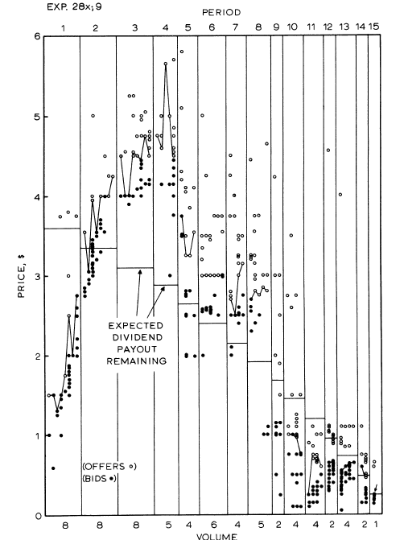
What happened
We observe a bubble and a crash!
What was happening?

Slide 38
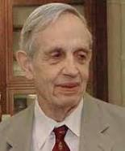
Game theory
Again here theorists are obsessed with equilibrium – here the Nash Equilibrium…
… in which everybody is doing the best for themselves given what everyone else is doing.
It is an equilibrium in the sense that once we are there, no individual can gain by changing his or her decision.
But is it attained?
Only experiments can tell us.

Slide 39
A simple two-person game
Two Players, Red and Blue.
Red chooses a row, Blue a column.
The payoffs to Red are in Red; those to Blue in Blue.
They choose simultaneously.
What is the Nash Equilibrium?
Is it achieved?
 | Column 1 | Column 2
Row 1 | €5, €5 | €20, €4
Row 2 | €4,€20 | €10, €10

Slide 40
Setting up an experiment to test the equilibrium of a game
Decide the number of players in the game.
Show them all the Payoff ‘Matrix’ which specifies, for each player, the payoff he/she would get for each set of decision of all the players.
Get them all (in a simultaneous play game) to simultaneously take their decision.
Use the Payoff ‘Matrix’ to determine the payoff of each player.
Pay them.
End of experiment.

Slide 41
A second simple two-person game
Two Players, Red and Blue.
Red chooses a row, Blue a column.
The payoffs to Red are in Red; those to Blue in Blue.
They choose simultaneously.
What is the Nash Equilibrium?
Is it achieved?
 | Column 1 | Column 2
Row 1 | €5, €5 | €110, €4
Row 2 | €4,€110 | €100, €100

Slide 42
A third simple two-person game
Two Players, Red and Blue.
Red chooses a row, Blue a column.
The payoffs to Red are in Red; those to Blue in Blue.
They choose simultaneously.
What is the Nash Equilibrium?
Is it achieved?
 | Column 1 | Column 2
Row 1 | €5, €5 | €10,001, €4
Row 2 | €4,€10,001 | €10,000, €10,000

Slide 43
What does this tell us?
Game theory ‘predictions’ are satisfied sometimes but not always.
It depends on the out-of-equilibrium payoffs – which are irrelevant to the theory.
Is out-of-equilibrium play a sign of trust, other-regarding preferences, or better-than-Nash rationality?
Other experiments can tell us.

Slide 44
A sequential-play game
A simple sequential one-shot Trust Game.
Two players, A and B. A has some money given to him/her by the experimenter; he can pass some to B and the amount becomes quadrupled.
Then B has to decide how much to pass back to A.
What is the Nash Equilibrium?
What do experiments show?
That Player A does pass some money – often 50% of the given amount.
Trust? Other-regarding preferences? Better-than-Nash rationality?

Slide 45
Axioms
Economists love axioms – definitions of ‘rationality’.
They are beautiful and intellectually appealing.
Consider this axiom – which is called the Independence Axiom.
Suppose you prefer A to B, where A and B can be anything.
Now suppose you are offered the following risky choice: between Left and Right. Which would you choose? C is anything. p is anything.
p
A
B
Left
Right
1-p
C
C
These are both risky choices with probabilities p and 1-p.

Slide 46
Now a test
What would you choose here?
And here?
£400
0.8
£300
0.2
£0
0.25
0.2
0.75
Are your decisions consistent with the Independence Axiom?
We can test this experimentally.

Slide 47
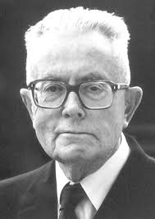
This is the Allais ‘paradox’
The Independence Axiom is the crucial part of Expected Utility theory.
Experimental tests of this axiom and others have led to the development of new theories of behaviour under risk, most notably Prospect theory and Rank-Dependent Expected Utility theory.
Allais (Nobel Prize 1988) was an early
experimenter in the field.

Slide 48
Dynamic choice
Dominated by strong ideas of rationality, particularly that of solving dynamic problems by backward induction (underlies rational expectations).
Consider the following dynamic problem.
In these green squares are decision nodes and red squares are where Nature moves, moving Up or Down with equal probabilities.
The amounts at the end are payoffs.
What would you do at the first decision node?
This is from an experiment of The Three Johns.

Slide 49
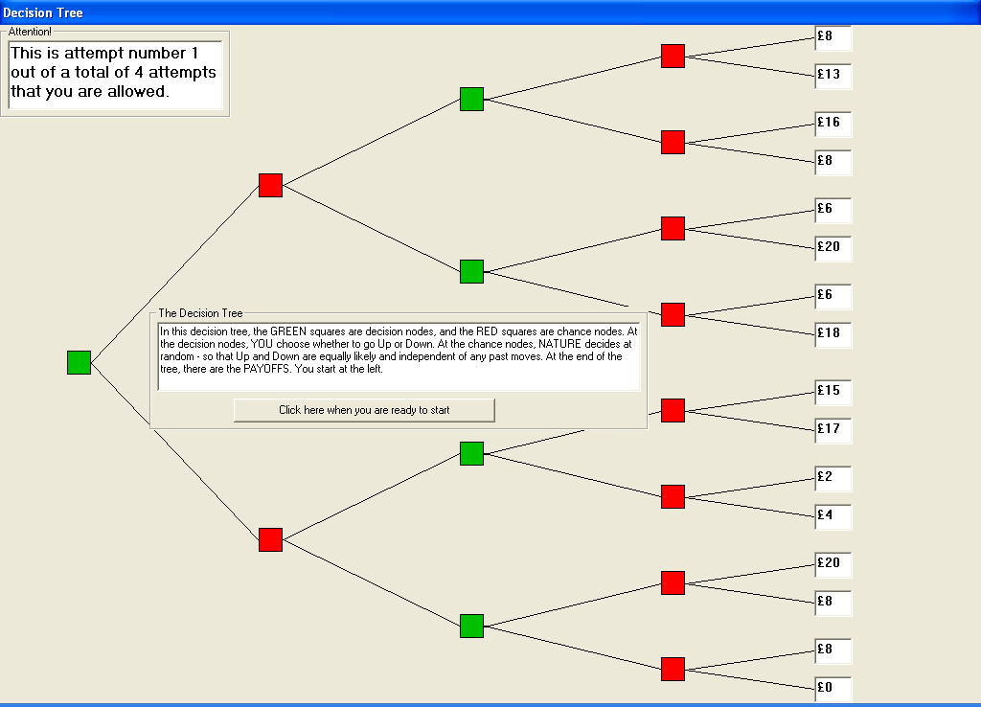

Slide 50
The Experimental Design
The payoffs in the top half of the tree are
8, 13,16, 8, 6, 20, 6,18
The payoffs in the bottom half of the tree are
15, 17, 2, 4, 29, 8, 8, 0
The ordered payoffs in the top half of the tree are
20, 18, 16, 13, 8, 8, 6, 6
The ordered payoffs in the bottom half of the tree are
20, 17, 15, 8, 8, 4, 2, 0
Top dominates bottom …
… but this ignores the second decision.

Slide 51
The Second Nodes
The decision maker would choose Down, Up, Up and Down (assuming dominance) therefore eliminating 8, 13, 6, 8, 2, 4, 8 and 0, leaving
16, 8, 6, 20 in the top (ordered 20, 16, 8 and 6) and
15, 17, 20, 8 in the bottom (ordered 20, 17, 15 and 8)
Now bottom dominates top.
Playing Down at the first node is a dominant strategy.
The experiment showed that well under half the subjects chose wrongly…
…and even forcing them to pre-commit to the second decision did not push the right choice to over 50%!

Slide 52
What the experiment shows
People do not plan ahead – even in the context of this simple example.
People do not backwardly induct.
What does economists’ theory of saving assume?
… backward induction from the date of death.

Slide 53
Savings
Economists, with their life-cycle theory of saving, assume that agents backwardly induct from the date of their death.
How do you do an experiment to test this?
An experiment with a finite number of periods in each of which the agent gets an income in tokens. Savings earn interest. Each period they have to decide how much of their wealth to convert into money – through a conversion scale u(.).
What do such experiments show?
That people under-save in early periods. Myopia?

Slide 54
So what have we learnt?
That spontaneous action can lead to equilibrium.
That equilibrium may not be achieved; that other factors are at play.
That the concepts of rationality used in much of economics are too strong.
People are myopic and do not use backward induction.
That people care about other people and trust them.
Experiments have led to new theories.

Slide 55
What has been learnt elsewhere?
People are different. Interesting?
Cultures are different. Interesting?
The more micro you look the more the differences.
People have noise in their behaviour but are not completely random.
Emotion seems to affect behaviour.
The environment seems to affect behaviour.
If we are interested in aggregate micro behaviour perhaps these differences cancel out?
But the behaviour of the average is not the average of behaviour.

Slide 56
Other experiments
I have not mentioned Field Experiments as I do not do them.
They are experiments carried out ‘in the field’ with perhaps the subjects not knowing that they are in an experiment.
Some experiments are carried out in low-income countries as one can provide higher incentives.

Slide 57
What non-experimenters say
“We know that the theory is true.”
Economics is about aggregates not individuals.
Your incentives are not large enough.
These axiomatic violations cancel out.
No comment.
Why are your theories about individuals?
We have tested whether their size makes a difference.
How do you know?

Slide 58
The end
Many thanks for listening.
My thanks to the University of Bari for inviting me to give this presentation.
I would be happy to answer any questions, either now or in the future.
Please send any messages to me at john.hey@york.ac.uk

